Slide 1
CSE 1121 Structured and Object Oriented Programming Language Department of Computer Science and Engineering DUET, Gazipur-1700
Md. Abu Bakkar Siddique
Lecturer, Department of CSE, DUET
Room # 7024, New Academic Building
Phone/Mobile: +880249274034-53 Ext: 3281, +8801944275646
Email: absiddique@duet.ac.bd, absduet@gmail.com

Slide 2
Lecture 07(Pointer)
Introduction to Pointer
Arithmetic Operation by Pointer
Call by reference
Pointer and Array
Passing array to a function by Pointer
Pointer and character string

Slide 3
Pointer
Pointers (pointer variables) are special variables that are used to store addresses rather than values.
Pointer Syntax:
data_type *pt_name;
int* p;
int *p1;
int * p2;
Pointer initialization:
int quantity, *p; /* declaration */
p = &quantity; /* initialization */
int *p1 = &quantity;
float a, b; int *p;
p=&a; /*wrong*/
int x, *p=&x;

Slide 4
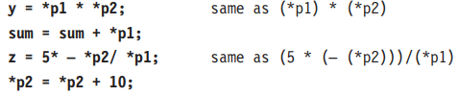
Pointer
Access Value by Pointers:
int* pc, c;
c = 5;
pc = &c;
printf("%d", *pc); // Output: 5
Changing Value Pointed by Pointers:
int* pc, c;
c = 5;
pc = &c;
*pc = 1;
printf("%d", c); // Output: 1
printf("%d", *pc); // Output: 1
Let's take another example.
int* pc, c;
c = 5;
pc = &c;
c = 1;
printf("%d", *pc); // Output: 1
printf("%d", c); // Output: 1

Slide 5
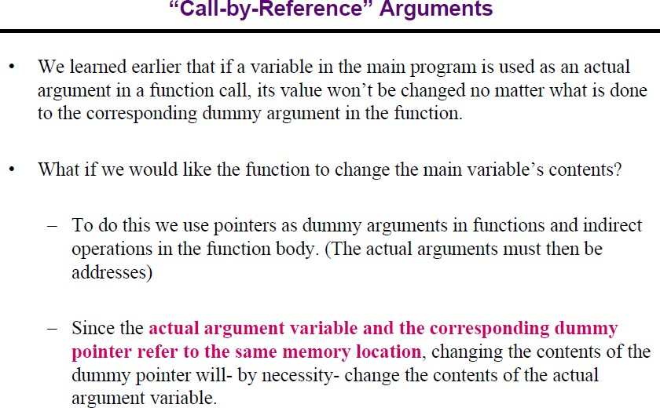

Slide 6
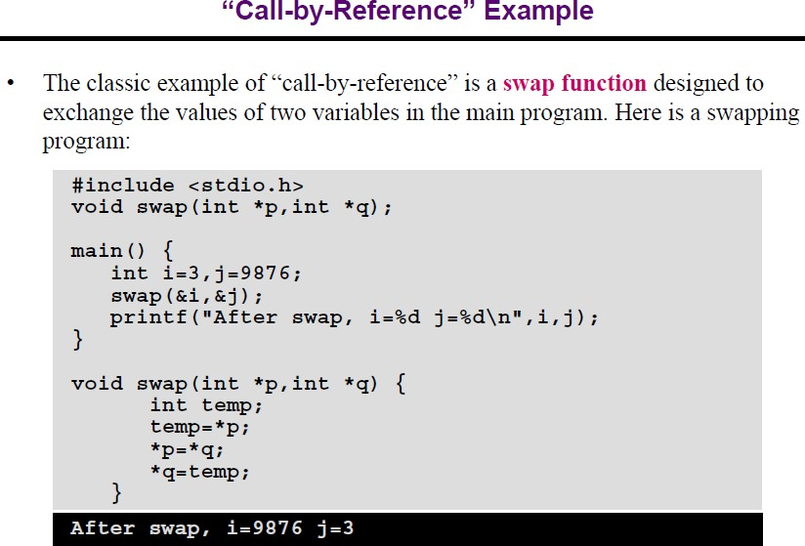

Slide 7
Relationship Between Arrays and Pointers
#include <stdio.h>
int main() {
int x[4], i;
for(i = 0; i < 4; ++i) {
printf("&x[%d] = %p\n", i, &x[i]);
}
printf("Address of array x: %p", x);
return 0;
}
From the above example, it is clear that &x[0] is equivalent to x. And, x[0] is equivalent to *x.
Similarly,
&x[1] is equivalent to x+1 and x[1] is equivalent to *(x+1).
&x[2] is equivalent to x+2 and x[2] is equivalent to *(x+2).
...
Basically, &x[i] is equivalent to x+i and x[i] is equivalent to *(x+i).
Output:
&x[0] = 0x7ffd1fedab70
&x[1] = 0x7ffd1fedab74
&x[2] = 0x7ffd1fedab78
&x[3] = 0x7ffd1fedab7c
Address of array x: 0x7ffd1fedab70

Slide 8
Relationship Between Arrays and Pointers
Example 1:
#include <stdio.h>
int main() {
int i, x[6], sum = 0;
printf("Enter 6 numbers: ");
for(i = 0; i < 6; ++i) {
// Equivalent to scanf("%d", &x[i]);
scanf("%d", x+i);
// Equivalent to sum += x[i]
sum += *(x+i);
}
printf("Sum = %d", sum);
return 0;
}
Output:
Enter 6 numbers: 2 3 4 4 12 4
Sum = 29
Example 2:
#include <stdio.h>
int main() {
int x[5] = {1, 2, 3, 4, 5};
int* ptr;
// ptr is assigned the address of the third element
ptr = &x[2];
printf("*ptr = %d \n", *ptr); // 3
printf("*(ptr+1) = %d \n", *(ptr+1)); // 4
printf("*(ptr-1) = %d", *(ptr-1)); // 2
return 0;
}
Output:
*ptr = 3
*(ptr+1) = 4
*(ptr-1) = 2

Slide 9
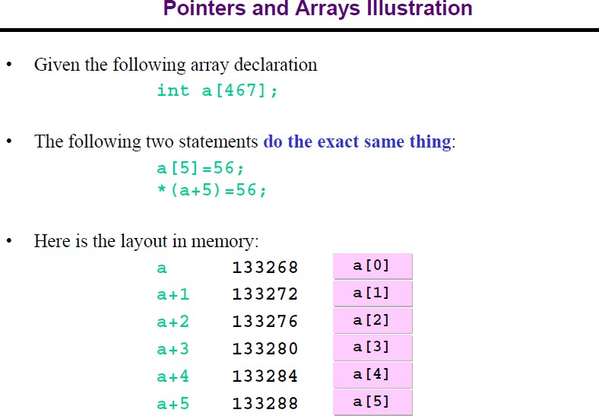

Slide 10
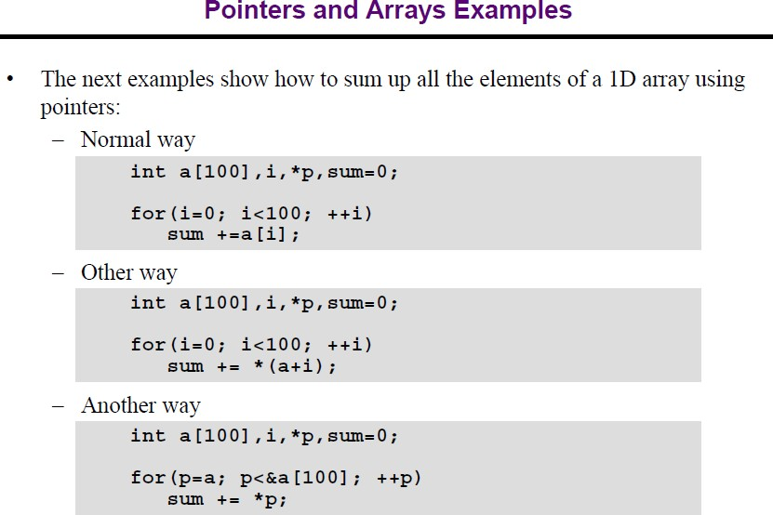

Slide 11
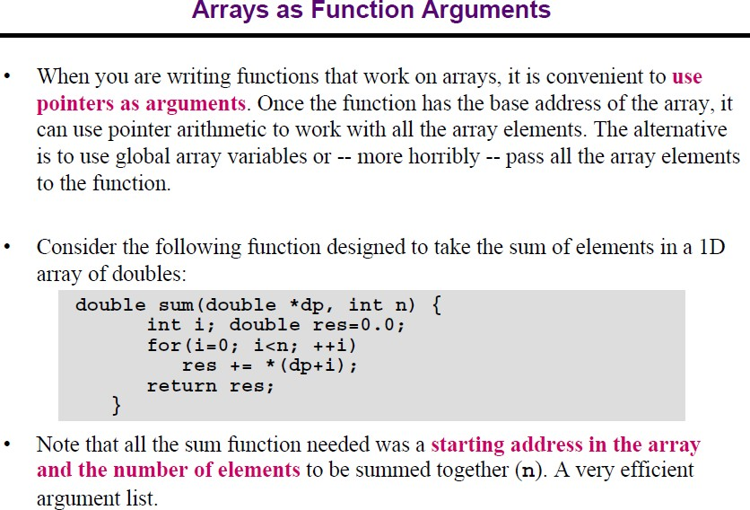

Slide 12
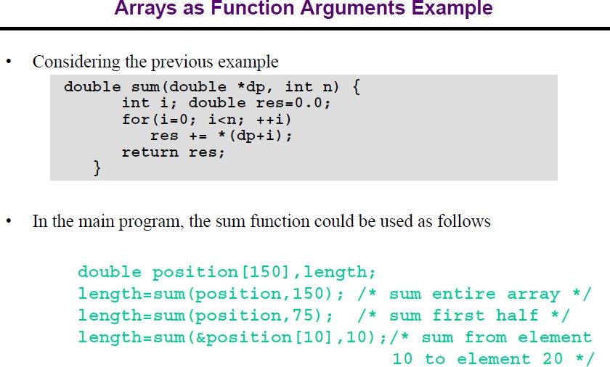

Slide 13
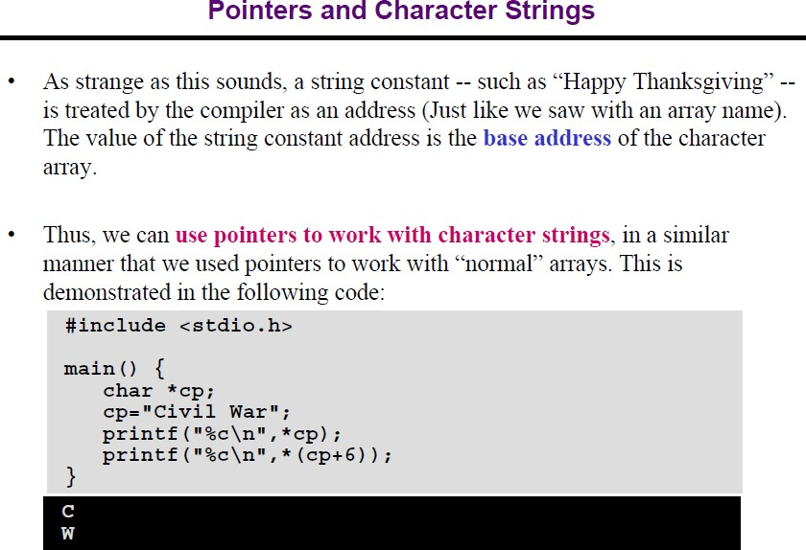

Slide 14
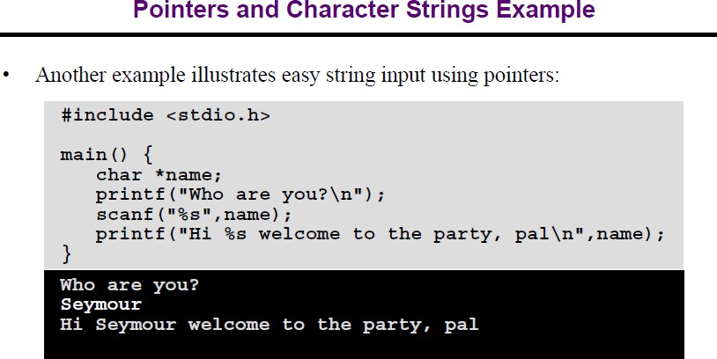

Slide 15

Any Question?

Slide 16
Thank You All !

